Slide 1
For Loops, While Loops, & If Statements
Rob Watkins

Slide 2
For Loops
For loops iterate over a given sequence

Slide 3
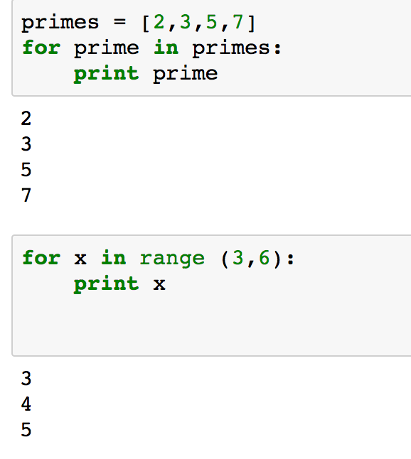
For Loop: Examples

Slide 4
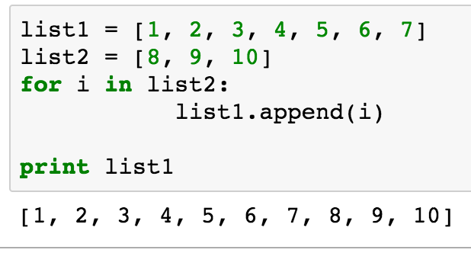
For Loops

Slide 5
While Loops
While loops repeat as long as a Boolean condition is met

Slide 6
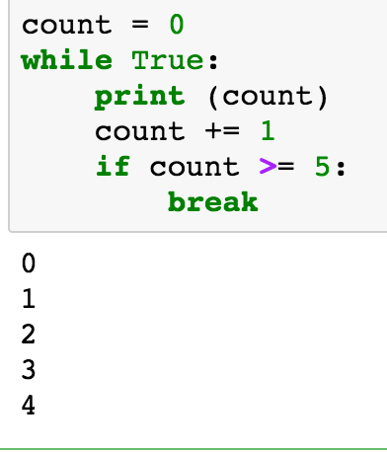
While Loop Example 1:

Slide 7
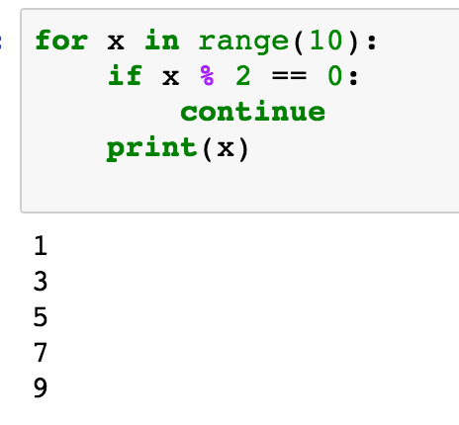
While loops: Print odd numbers less than 10

Slide 8
Continue Function
The continue function returns the control to the beginning of the while loop.
The continue statement rejects all the remaining statements in the current iteration of the loop and moves the control back to the top of the lop.

Slide 9
If Statements
Used when we want to check if something is the case
If it is the case, we should do something…..
Otherwise, we should continue and not do anything associated with the if statement
Frequently paired with assignment operators:
< <= => > == =

Slide 10
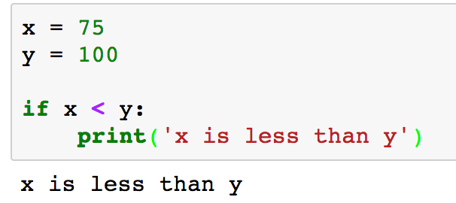
If Statements

Slide 11
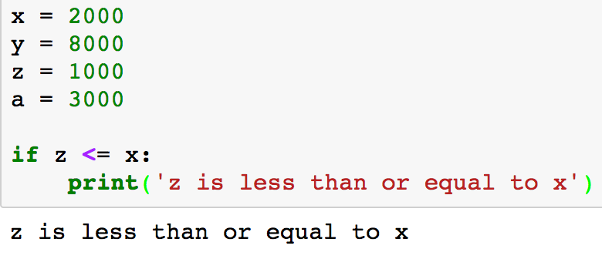
If Statements

Slide 12
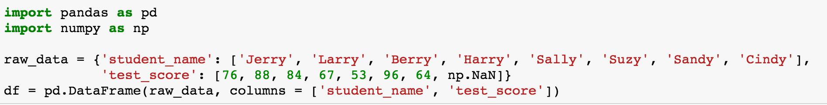
If Statements using Pandas and NumPy

Slide 13
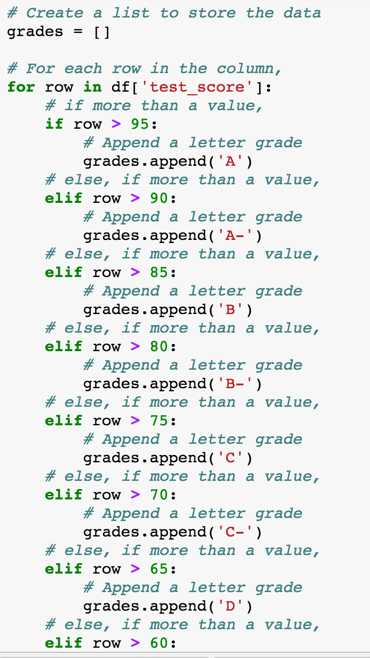
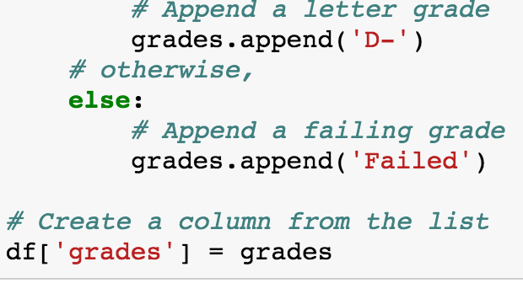

Slide 14
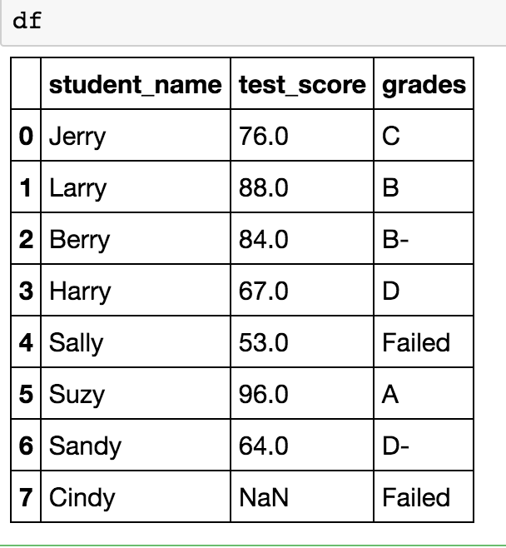

Slide 15
~FIN~

